Slide 1
Call No Man UNHOLY Or Unclean
Acts 10
Notes:
Read Acts 9:32 through 10:48 over the next two slides

Slide 2
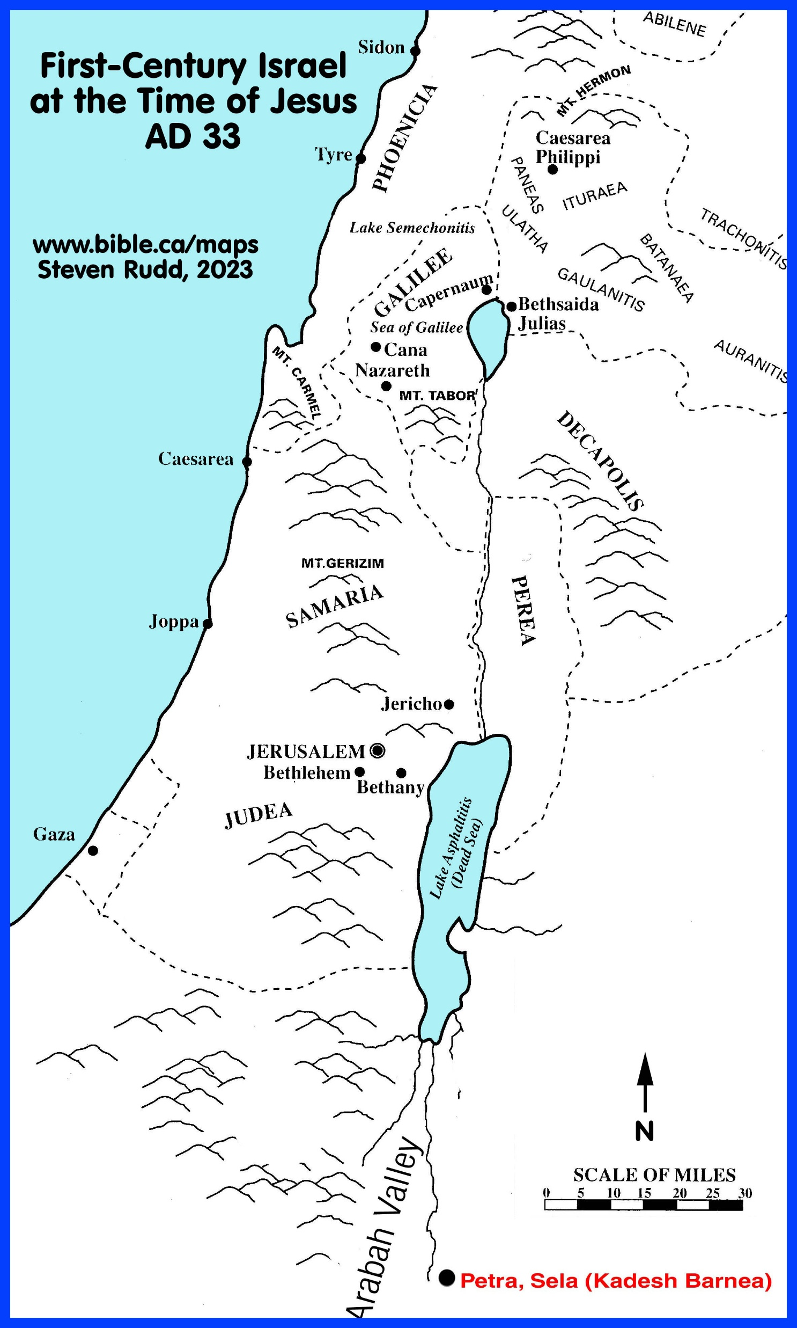
Notes:
Lydda is about 18 miles inland from Joppa
Joppa (modern day Jaffa, a suburb of Tel-Aviv) is about 25 miles down the coast from Caesarea

Slide 3
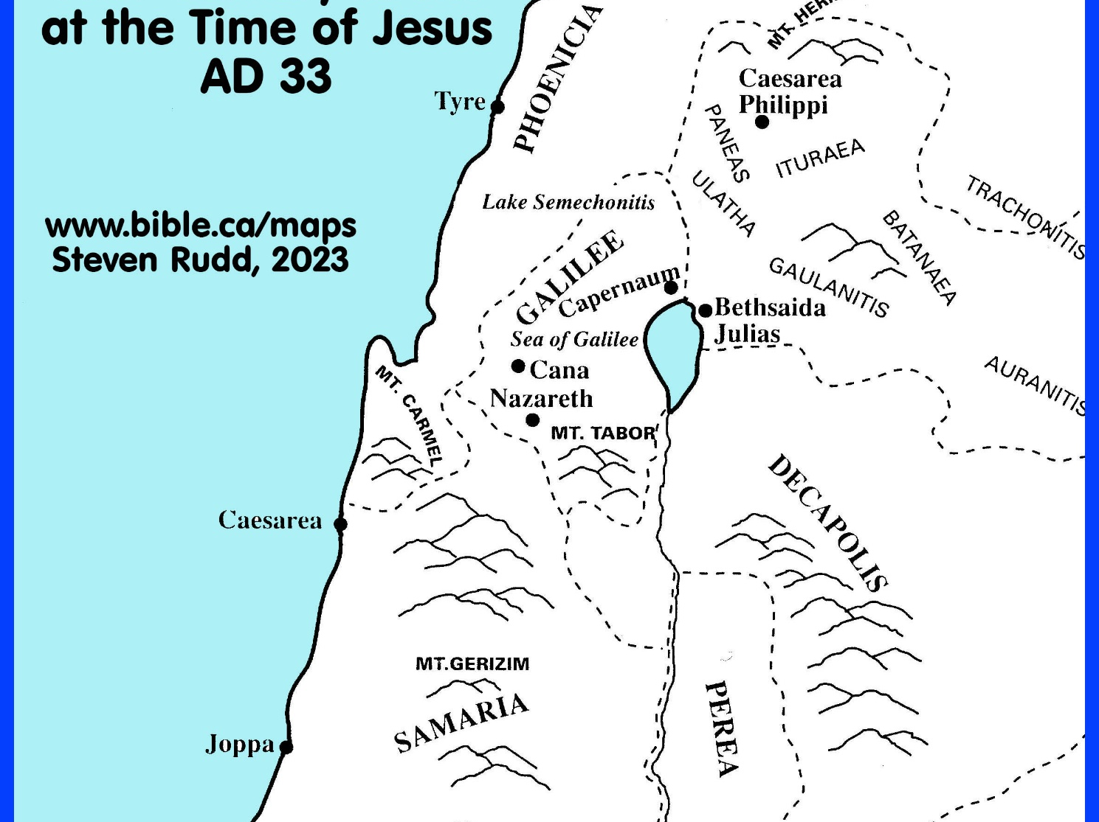
Notes:
Read Acts 9:32 through 10:48

Slide 4
Call No Man UNHOLY Or Unclean
“Opening his mouth, Peter said: ‘I most certainly understand now that God is not one to show partiality, but in every nation the man who fears Him and does what is right is welcome to Him.’” (Acts 10:34-35)

Slide 5
Lessons On Prejudice

Slide 6
The Gospel is universal.
Peter should have already understood this principle.
Prophecies. Isaiah 2:2-4; Joel 2:32a; cf. Acts 2:21
Christ’s personal ministry. John 10:16; cf. Ephesians 2:14-16
Great Commission. Matthew 28:18-20; Mark 16:15-16; Luke 24:45-47
Part of Christ’s last message to the apostles. Acts 1:8 (compare to Matthew 10:5-6)
Peter had understood it before. Acts 2:39
Notes:
Isaiah 2:2-4 Now it will come about that In the last days The mountain of the house of the Lord Will be established as the chief of the mountains, And will be raised above the hills; And all the nations will stream to it. ³ And many peoples will come and say, “Come, let us go up to the mountain of the Lord, To the house of the God of Jacob; That He may teach us concerning His ways And that we may walk in His paths.” For the law will go forth from Zion And the word of the Lord from Jerusalem. ⁴ And He will judge between the nations, And will render decisions for many peoples; And they will hammer their swords into plowshares and their spears into pruning hooks. Nation will not lift up sword against nation, And never again will they learn war.
Joel 2:32a “And it will come about that whoever calls on the name of the Lord Will be delivered;
Acts 2:21 ‘And it shall be that everyone who calls on the name of the Lord will be saved.’
John 10:16 I have other sheep, which are not of this fold; I must bring them also, and they will hear My voice; and they will become one flock with one shepherd.
Ephesians 2:14-16 For He Himself is our peace, who made both groups into one and broke down the barrier of the dividing wall, ¹⁵ by abolishing in His flesh the enmity, which is the Law of commandments contained in ordinances, so that in Himself He might make the two into one new man, thus establishing peace, ¹⁶ and might reconcile them both in one body to God through the cross, by it having put to death the enmity.
Matthew 28:18-20 And Jesus came up and spoke to them, saying, “All authority has been given to Me in heaven and on earth. ¹⁹ Go therefore and make disciples of all the nations, baptizing them in the name of the Father and the Son and the Holy Spirit, ²⁰ teaching them to observe all that I commanded you; and lo, I am with you always, even to the end of the age.”
Mark 16:15-16 And He said to them, “Go into all the world and preach the gospel to all creation. ¹⁶ He who has believed and has been baptized shall be saved; but he who has disbelieved shall be condemned.
Luke 24:45-47 Then He opened their minds to understand the Scriptures, ⁴⁶ and He said to them, “Thus it is written, that the Christ would suffer and rise again from the dead the third day, ⁴⁷ and that repentance for forgiveness of sins would be proclaimed in His name to all the nations, beginning from Jerusalem.
Acts 1:8 but you will receive power when the Holy Spirit has come upon you; and you shall be My witnesses both in Jerusalem, and in all Judea and Samaria, and even to the remotest part of the earth.”
Matthew 10:5-6 These twelve Jesus sent out after instructing them: “Do not go in the way of the Gentiles, and do not enter any city of the Samaritans; ⁶ but rather go to the lost sheep of the house of Israel.
Acts 2:39 For the promise is for you and your children and for all who are far off, as many as the Lord our God will call to Himself.”

Slide 7
The Gospel is universal.
All the apostles should have already understood this for the same reasons.
YET, they challenged Peter. Acts 11:1-18
LATER, Peter succumbed to peer pressure and was reproved by Paul. Galatians 2:11-13
Notes:
Acts 11:1-18 Now the apostles and the brethren who were throughout Judea heard that the Gentiles also had received the word of God. ² And when Peter came up to Jerusalem, those who were circumcised took issue with him, ³ saying, “You went to uncircumcised men and ate with them.” ⁴ But Peter began speaking and proceeded to explain to them in orderly sequence, saying, ⁵ “I was in the city of Joppa praying; and in a trance I saw a vision, an object coming down like a great sheet lowered by four corners from the sky; and it came right down to me, ⁶ and when I had fixed my gaze on it and was observing it I saw the four-footed animals of the earth and the wild beasts and the crawling creatures and the birds of the air. ⁷ I also heard a voice saying to me, ‘Get up, Peter; kill and eat.’ ⁸ But I said, ‘By no means, Lord, for nothing unholy or unclean has ever entered my mouth.’ ⁹ But a voice from heaven answered a second time, ‘What God has cleansed, no longer consider unholy.’ ¹⁰ This happened three times, and everything was drawn back up into the sky. ¹¹ And behold, at that moment three men appeared at the house in which we were staying, having been sent to me from Caesarea. ¹² The Spirit told me to go with them without misgivings. These six brethren also went with me and we entered the man’s house. ¹³ And he reported to us how he had seen the angel standing in his house, and saying, ‘Send to Joppa and have Simon, who is also called Peter, brought here; ¹⁴ and he will speak words to you by which you will be saved, you and all your household.’ ¹⁵ And as I began to speak, the Holy Spirit fell upon them just as He did upon us at the beginning. ¹⁶ And I remembered the word of the Lord, how He used to say, ‘John baptized with water, but you will be baptized with the Holy Spirit.’ ¹⁷ Therefore if God gave to them the same gift as He gave to us also after believing in the Lord Jesus Christ, who was I that I could stand in God’s way?” ¹⁸ When they heard this, they quieted down and glorified God, saying, “Well then, God has granted to the Gentiles also the repentance that leads to life.”
Galatians 2:11-13 But when Cephas came to Antioch, I opposed him to his face, because he stood condemned. ¹² For prior to the coming of certain men from James, he used to eat with the Gentiles; but when they came, he began to withdraw and hold himself aloof, fearing the party of the circumcision. ¹³ The rest of the Jews joined him in hypocrisy, with the result that even Barnabas was carried away by their hypocrisy.

Slide 8
The Gospel is universal.
In Christ we are not to make distinctions among people. Galatians 3:28
Christ died to remove barriers. Ephesians 2:11-15
Paul taught against such distinctions. Philippians 3:2-8
James taught no social distinctions. James 2:1-5
Notes:
Galatians 3:28 There is neither Jew nor Greek, there is neither slave nor free man, there is neither male nor female; for you are all one in Christ Jesus.
Ephesians 2:11-15 Therefore remember that formerly you, the Gentiles in the flesh, who are called “Uncircumcision” by the so-called “Circumcision,” which is performed in the flesh by human hands— ¹² remember that you were at that time separate from Christ, excluded from the commonwealth of Israel, and strangers to the covenants of promise, having no hope and without God in the world. ¹³ But now in Christ Jesus you who formerly were far off have been brought near by the blood of Christ. ¹⁴ For He Himself is our peace, who made both groups into one and broke down the barrier of the dividing wall, ¹⁵ by abolishing in His flesh the enmity, which is the Law of commandments contained in ordinances, so that in Himself He might make the two into one new man, thus establishing peace,
Philippians 3:2-8 Beware of the dogs, beware of the evil workers, beware of the false circumcision; ³ for we are the true circumcision, who worship in the Spirit of God and glory in Christ Jesus and put no confidence in the flesh, ⁴ although I myself might have confidence even in the flesh. If anyone else has a mind to put confidence in the flesh, I far more: ⁵ circumcised the eighth day, of the nation of Israel, of the tribe of Benjamin, a Hebrew of Hebrews; as to the Law, a Pharisee; ⁶ as to zeal, a persecutor of the church; as to the righteousness which is in the Law, found blameless. ⁷ But whatever things were gain to me, those things I have counted as loss for the sake of Christ. ⁸ More than that, I count all things to be loss in view of the surpassing value of knowing Christ Jesus my Lord, for whom I have suffered the loss of all things, and count them but rubbish so that I may gain Christ,
James 2:1-5 My brethren, do not hold your faith in our glorious Lord Jesus Christ with an attitude of personal favoritism. ² For if a man comes into your assembly with a gold ring and dressed in fine clothes, and there also comes in a poor man in dirty clothes, ³ and you pay special attention to the one who is wearing the fine clothes, and say, “You sit here in a good place,” and you say to the poor man, “You stand over there, or sit down by my footstool,” ⁴ have you not made distinctions among yourselves, and become judges with evil motives? ⁵ Listen, my beloved brethren: did not God choose the poor of this world to be rich in faith and heirs of the kingdom which He promised to those who love Him?

Slide 9
Lessons on Conversion

Slide 10
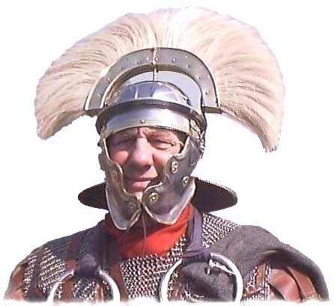
Characteristics of Cornelius Acts 10
Centurion … military officer. Verse 1
“Devout” Verse 2
Had a reverent family. Verse 2
Charitable. “gave alms” Verse 2
Prayed always. Verse 2
Well spoken of. Verse 22
Notes:
Acts 10:1-2 Now there was a man at Caesarea named Cornelius, a centurion of what was called the Italian cohort, ² a devout man and one who feared God with all his household, and gave many alms to the Jewish people and prayed to God continually.
Acts 10:22 They said, “Cornelius, a centurion, a righteous and God-fearing man well spoken of by the entire nation of the Jews, was divinely directed by a holy angel to send for you to come to his house and hear a message from you.”

Slide 11
Outstanding character.
Religious. Acts 10:2
Desired to know. Acts 10:33
Morality cannot remove sin.
However, morality is necessary. Ephesians 5:3-11; 1 Peter 2:11-12
Notes:
Acts 10:2 a devout man and one who feared God with all his household, and gave many alms to the Jewish people and prayed to God continually.
Acts 10:33 So I sent for you immediately, and you have been kind enough to come. Now then, we are all here present before God to hear all that you have been commanded by the Lord.”
Ephesians 5:3-11 But immorality or any impurity or greed must not even be named among you, as is proper among saints; ⁴ and there must be no filthiness and silly talk, or coarse jesting, which are not fitting, but rather giving of thanks. ⁵ For this you know with certainty, that no immoral or impure person or covetous man, who is an idolater, has an inheritance in the kingdom of Christ and God. ⁶ Let no one deceive you with empty words, for because of these things the wrath of God comes upon the sons of disobedience. ⁷ Therefore do not be partakers with them; ⁸ for you were formerly darkness, but now you are Light in the Lord; walk as children of Light ⁹ (for the fruit of the Light consists in all goodness and righteousness and truth), ¹⁰ trying to learn what is pleasing to the Lord. ¹¹ Do not participate in the unfruitful deeds of darkness, but instead even expose them;
1 Peter 2:11-12 Beloved, I urge you as aliens and strangers to abstain from fleshly lusts which wage war against the soul. ¹² Keep your behavior excellent among the Gentiles, so that in the thing in which they slander you as evildoers, they may because of your good deeds, as they observe them, glorify God in the day of visitation.

Slide 12
Miracle #1
Angel appeared to Cornelius. Acts 10:3-8
Cornelius praying. cf. 1 Peter 3:12
Memorial cf. Genesis 3:15; 12:1-3; 22:18
Told Cornelius what to do. Acts 10:5
Acts 11:13-14; Titus 3:5
Notes:
Acts 10: 3-8 About the ninth hour of the day he clearly saw in a vision an angel of God who had just come in and said to him, “Cornelius!” ⁴ And fixing his gaze on him and being much alarmed, he said, “What is it, Lord?” And he said to him, “Your prayers and alms have ascended as a memorial before God. ⁵ Now dispatch some men to Joppa and send for a man named Simon, who is also called Peter; ⁶ he is staying with a tanner named Simon, whose house is by the sea.” ⁷ When the angel who was speaking to him had left, he summoned two of his servants and a devout soldier of those who were his personal attendants, ⁸ and after he had explained everything to them, he sent them to Joppa.
1 Peter 3:12 (Quoting Psalm 34:15-16) “For the eyes of the Lord are toward the righteous, And His ears attend to their prayer, But the face of the Lord is against those who do evil.”
Gen 3:15 And I will put enmity Between you and the woman, And between your seed and her seed; He shall bruise you on the head, And you shall bruise him on the heel.”
Gen 12:1-3 Now the Lord said to Abram, “Go forth from your country, And from your relatives And from your father’s house, To the land which I will show you; ² And I will make you a great nation, And I will bless you, And make your name great; And so you shall be a blessing; ³ And I will bless those who bless you, And the one who curses you I will curse. And in you all the families of the earth will be blessed.”
Gen 22:18 In your seed all the nations of the earth shall be blessed, because you have obeyed My voice.”
Acts 10: 5 ⁵ Now dispatch some men to Joppa and send for a man named Simon, who is also called Peter; ⁶ he is staying with a tanner named Simon, whose house is by the sea.”
Acts 11:13-14 And he reported to us how he had seen the angel standing in his house, and saying, ‘Send to Joppa and have Simon, who is also called Peter, brought here; ¹⁴ and he will speak words to you by which you will be saved, you and all your household.’
Titus 3:5 He saved us, not on the basis of deeds which we have done in righteousness, but according to His mercy, by the washing of regeneration and renewing by the Holy Spirit,

Slide 13
Miracle #2
Peter’s vision.
Men on way to Joppa. Verses 7-8
Had previously preached only to Jews. But the vision and the Voice, 3 times in-a-row, was convincing. Verses 9-16
Notes:
Acts 10: 7-8 When the angel who was speaking to him had left, he summoned two of his servants and a devout soldier of those who were his personal attendants, ⁸ and after he had explained everything to them, he sent them to Joppa.
Acts 10:9-16 On the next day, as they were on their way and approaching the city, Peter went up on the housetop about the sixth hour to pray. But he became hungry and was desiring to eat; but while they were making preparations, he fell into a trance; ¹¹ and he *saw the sky opened up, and an object like a great sheet coming down, lowered by four corners to the ground, ¹² and there were in it all kinds of four-footed animals and crawling creatures of the earth and birds of the air. ¹³ A voice came to him, “Get up, Peter, kill and eat!” ¹⁴ But Peter said, “By no means, Lord, for I have never eaten anything unholy and unclean.” ¹⁵ Again a voice came to him a second time, “What God has cleansed, no longer consider unholy.” ¹⁶ This happened three times, and immediately the object was taken up into the sky.

Slide 14
Miracle # 3
The Spirit assists in same matter. Verses 19-20
Peter goes with six brethren. Verse 23; Acts 11:12
Notes:
Acts 10:19-20 While Peter was reflecting on the vision, the Spirit said to him, “Behold, three men are looking for you. ²⁰ But get up, go downstairs and accompany them without misgivings, for I have sent them Myself.”
Acts 10:23 So he invited them in and gave them lodging. And on the next day he got up and went away with them, and some of the brethren from Joppa accompanied him.
Acts 11:12 The Spirit told me to go with them without misgivings. These six brethren also went with me and we entered the man’s house.

Slide 15
Meeting at home of Cornelius.
Peter refuses to be worshipped. Verses 25-26
Cornelius relates his experience. Verses 30-32
Many present “to hear all that you have been commanded.” Verse 33
Notes:
Acts 10: 25-26 When Peter entered, Cornelius met him, and fell at his feet and worshiped him. ²⁶ But Peter raised him up, saying, “Stand up; I too am just a man.”
Acts 10:30-32 Cornelius said, “Four days ago to this hour, I was praying in my house during the ninth hour; and behold, a man stood before me in shining garments, ³¹ and he *said, ‘Cornelius, your prayer has been heard and your alms have been remembered before God. ³² Therefore send to Joppa and invite Simon, who is also called Peter, to come to you; he is staying at the house of Simon the tanner by the sea.’
Acts 10:33 So I sent for you immediately, and you have been kind enough to come. Now then, we are all here present before God to hear all that you have been commanded by the Lord.”

Slide 16
Peter’s sermon. Verses 34-43
1. No partiality with God.
Must fear God. cf. Ecclesiastes 12:13; Hebrews 10:31; Romans 11:22; 2 Corinthians 5:11
“Honor all people, love the brotherhood, fear God, honor the king.” (1 Peter 2:17)
Work righteousness.
“Let my tongue sing of Your word, for all Your commandments are righteousness.” (Psalm 119:172) cf. Romans 10:1-10
Notes:
Acts 10:34-43 Opening his mouth, Peter said: “I most certainly understand now that God is not one to show partiality, ³⁵ but in every nation the man who fears Him and does what is right is welcome to Him. ³⁶ The word which He sent to the sons of Israel, preaching peace through Jesus Christ (He is Lord of all)— ³⁷ you yourselves know the thing which took place throughout all Judea, starting from Galilee, after the baptism which John proclaimed. ³⁸ You know of Jesus of Nazareth, how God anointed Him with the Holy Spirit and with power, and how He went about doing good and healing all who were oppressed by the devil, for God was with Him. ³⁹ We are witnesses of all the things He did both in the land of the Jews and in Jerusalem. They also put Him to death by hanging Him on a cross. ⁴⁰ God raised Him up on the third day and granted that He become visible, ⁴¹ not to all the people, but to witnesses who were chosen beforehand by God, that is, to us who ate and drank with Him after He arose from the dead. ⁴² And He ordered us to preach to the people, and solemnly to testify that this is the One who has been appointed by God as Judge of the living and the dead. ⁴³ Of Him all the prophets bear witness that through His name everyone who believes in Him receives forgiveness of sins.”
Ecclesiastes 12:13 (ESV) The end of the matter; all has been heard. Fear God and keep his commandments, for this is the whole duty of man.
Hebrews 10:31 It is a terrifying thing to fall into the hands of the living God.
Romans 11:22 Behold then the kindness and severity of God; to those who fell, severity, but to you, God’s kindness, if you continue in His kindness; otherwise you also will be cut off.
2 Corinthians 5:11 Therefore, knowing the fear of the Lord, we persuade men, but we are made manifest to God; and I hope that we are made manifest also in your consciences.
Romans 10:1-10 Brethren, my heart’s desire and my prayer to God for them is for their salvation. ² For I testify about them that they have a zeal for God, but not in accordance with knowledge. ³ For not knowing about God’s righteousness and seeking to establish their own, they did not subject themselves to the righteousness of God. ⁴ For Christ is the end of the law for righteousness to everyone who believes.
⁵ For Moses writes that the man who practices the righteousness which is based on law shall live by that righteousness. ⁶ But the righteousness based on faith speaks as follows: “Do not say in your heart, ‘Who will ascend into heaven?’ (that is, to bring Christ down), ⁷ or ‘Who will descend into the abyss?’ (that is, to bring Christ up from the dead).” ⁸ But what does it say? “The word is near you, in your mouth and in your heart”—that is, the word of faith which we are preaching, ⁹ that if you confess with your mouth Jesus as Lord, and believe in your heart that God raised Him from the dead, you will be saved; ¹⁰ for with the heart a person believes, resulting in righteousness, and with the mouth he confesses, resulting in salvation.

Slide 17
Peter’s sermon. Verses 34-43
2. Salvation through Christ. Verses 36-43
Anointed. cf. John 1:32-34
Killed. cf. Acts 2:36; 3:13-15; 4:10; 5:29
Raised. 1 Corinthians 15:3-4
Judge. Acts 17:30-31
Fulfilled the prophecies. Luke 24:44
Offers remission. Acts 2:38; 13:38
Notes:
Acts 10:34-43 Opening his mouth, Peter said: “I most certainly understand now that God is not one to show partiality, ³⁵ but in every nation the man who fears Him and does what is right is welcome to Him. ³⁶ The word which He sent to the sons of Israel, preaching peace through Jesus Christ (He is Lord of all)— ³⁷ you yourselves know the thing which took place throughout all Judea, starting from Galilee, after the baptism which John proclaimed. ³⁸ You know of Jesus of Nazareth, how God anointed Him with the Holy Spirit and with power, and how He went about doing good and healing all who were oppressed by the devil, for God was with Him. ³⁹ We are witnesses of all the things He did both in the land of the Jews and in Jerusalem. They also put Him to death by hanging Him on a cross. ⁴⁰ God raised Him up on the third day and granted that He become visible, ⁴¹ not to all the people, but to witnesses who were chosen beforehand by God, that is, to us who ate and drank with Him after He arose from the dead. ⁴² And He ordered us to preach to the people, and solemnly to testify that this is the One who has been appointed by God as Judge of the living and the dead. ⁴³ Of Him all the prophets bear witness that through His name everyone who believes in Him receives forgiveness of sins.”
John 1:32-34 John testified saying, “I have seen the Spirit descending as a dove out of heaven, and He remained upon Him. ³³ I did not recognize Him, but He who sent me to baptize in water said to me, ‘He upon whom you see the Spirit descending and remaining upon Him, this is the One who baptizes in the Holy Spirit.’ ³⁴ I myself have seen, and have testified that this is the Son of God.”
Acts 2:36 Therefore let all the house of Israel know for certain that God has made Him both Lord and Christ—this Jesus whom you crucified.”
Acts 3:13-15 The God of Abraham, Isaac and Jacob, the God of our fathers, has glorified His servant Jesus, the one whom you delivered and disowned in the presence of Pilate, when he had decided to release Him. ¹⁴ But you disowned the Holy and Righteous One and asked for a murderer to be granted to you, ¹⁵ but put to death the Prince of life, the one whom God raised from the dead, a fact to which we are witnesses.
Acts 4:10 let it be known to all of you and to all the people of Israel, that by the name of Jesus Christ the Nazarene, whom you crucified, whom God raised from the dead—by this name this man stands here before you in good health.
Acts 5:30 The God of our fathers raised up Jesus, whom you had put to death by hanging Him on a cross.
1 Corinthians 15:3-4 For I delivered to you as of first importance what I also received, that Christ died for our sins according to the Scriptures, ⁴ and that He was buried, and that He was raised on the third day according to the Scriptures,
Acts 17:30-31 Therefore having overlooked the times of ignorance, God is now declaring to men that all people everywhere should repent, ³¹ because He has fixed a day in which He will judge the world in righteousness through a Man whom He has appointed, having furnished proof to all men by raising Him from the dead.”
Luke 24:44 Now He said to them, “These are My words which I spoke to you while I was still with you, that all things which are written about Me in the Law of Moses and the Prophets and the Psalms must be fulfilled.”
Acts 2:38 Peter said to them, “Repent, and each of you be baptized in the name of Jesus Christ for the forgiveness of your sins; and you will receive the gift of the Holy Spirit.
Acts 13:38 Therefore let it be known to you, brethren, that through Him forgiveness of sins is proclaimed to you,

Slide 18
Peter’s sermon. Verses 34-43
3. What man must do.
Hear words. Acts 10:22; 11:13-14
Believe in Christ. cf. Acts 10:43
Repent. Acts 11:18
Be baptized. Acts 10:48
Notes:
Acts 10:22 They said, “Cornelius, a centurion, a righteous and God-fearing man well spoken of by the entire nation of the Jews, was divinely directed by a holy angel to send for you to come to his house and hear a message from you.”
Acts 11:13-14 And he reported to us how he had seen the angel standing in his house, and saying, ‘Send to Joppa and have Simon, who is also called Peter, brought here; ¹⁴ and he will speak words to you by which you will be saved, you and all your household.’
Acts 10:43 Of Him all the prophets bear witness that through His name everyone who believes in Him receives forgiveness of sins.”
Acats 11: 18 When they heard this, they quieted down and glorified God, saying, “Well then, God has granted to the Gentiles also the repentance that leads to life.”
Acts 10:48 And he ordered them to be baptized in the name of Jesus Christ. Then they asked him to stay on for a few days.

Slide 19
Miracle # 4
Holy Spirit fell upon them. Acts 10:44; 11:15
Not to save. Acts 11:13-14
Not to give faith. Acts 15:7
Not to purify heart. Acts 15:9; Romans 10:17
Not to give remission. Acts 10:43
Not to purify soul. 1 Peter 1:22
Not to sanctify. John 17:17
Notes:
Acts 10:44 While Peter was still speaking these words, the Holy Spirit fell upon all those who were listening to the message.
Acts 11:15 And as I began to speak, the Holy Spirit fell upon them just as He did upon us at the beginning.
Acts 11:13-14 And he reported to us how he had seen the angel standing in his house, and saying, ‘Send to Joppa and have Simon, who is also called Peter, brought here; ¹⁴ and he will speak words to you by which you will be saved, you and all your household.’
Acts 15:7 After there had been much debate, Peter stood up and said to them, “Brethren, you know that in the early days God made a choice among you, that by my mouth the Gentiles would hear the word of the gospel and believe.
Acts 15:9 and He made no distinction between us and them, cleansing their hearts by faith.
Romans 10:17 So faith comes from hearing, and hearing by the word of Christ.
Acts 10:43 Of Him all the prophets bear witness that through His name everyone who believes in Him receives forgiveness of sins.”
1 Peter 1:22 Since you have in obedience to the truth purified your souls for a sincere love of the brethren, fervently love one another from the heart,
John 17:17 Sanctify them in the truth; Your word is truth.

Slide 20
Miracle # 4
Holy Spirit fell upon them. Acts 10:44; 11:15
To convince Jewish brethren. Acts 10:44-47
Others at Jerusalem. Acts 11:15-18
Notes:
Acts 10:44-47 While Peter was still speaking these words, the Holy Spirit fell upon all those who were listening to the message. ⁴⁵ All the circumcised believers who came with Peter were amazed, because the gift of the Holy Spirit had been poured out on the Gentiles also. ⁴⁶ For they were hearing them speaking with tongues and exalting God. Then Peter answered, ⁴⁷ “Surely no one can refuse the water for these to be baptized who have received the Holy Spirit just as we did, can he?”
Acts 11:15-18 And as I began to speak, the Holy Spirit fell upon them just as He did upon us at the beginning. ¹⁶ And I remembered the word of the Lord, how He used to say, ‘John baptized with water, but you will be baptized with the Holy Spirit.’ ¹⁷ Therefore if God gave to them the same gift as He gave to us also after believing in the Lord Jesus Christ, who was I that I could stand in God’s way?” ¹⁸ When they heard this, they quieted down and glorified God, saying, “Well then, God has granted to the Gentiles also the repentance that leads to life.”

Slide 21
Peter’s sermon to Cornelius is the same sermon to all. Verses 34-43
What man must do.
Hear words. Acts 10:22; 11:13-14
Believe in Christ. cf. Acts 10:43
Repent. Acts 11:18
Be baptized. Acts 10:48
Notes:
Acts 10:34-43 Opening his mouth, Peter said: “I most certainly understand now that God is not one to show partiality, ³⁵ but in every nation the man who fears Him and does what is right is welcome to Him.
³⁶ The word which He sent to the sons of Israel, preaching peace through Jesus Christ (He is Lord of all)— ³⁷ you yourselves know the thing which took place throughout all Judea, starting from Galilee, after the baptism which John proclaimed. ³⁸ You know of Jesus of Nazareth, how God anointed Him with the Holy Spirit and with power, and how He went about doing good and healing all who were oppressed by the devil, for God was with Him. ³⁹ We are witnesses of all the things He did both in the land of the Jews and in Jerusalem. They also put Him to death by hanging Him on a cross. ⁴⁰ God raised Him up on the third day and granted that He become visible, ⁴¹ not to all the people, but to witnesses who were chosen beforehand by God, that is, to us who ate and drank with Him after He arose from the dead. ⁴² And He ordered us to preach to the people, and solemnly to testify that this is the One who has been appointed by God as Judge of the living and the dead. ⁴³ Of Him all the prophets bear witness that through His name everyone who believes in Him receives forgiveness of sins.”
Acts 10:22 They said, “Cornelius, a centurion, a righteous and God-fearing man well spoken of by the entire nation of the Jews, was divinely directed by a holy angel to send for you to come to his house and hear a message from you.”
Acts 11:13-14 And he reported to us how he had seen the angel standing in his house, and saying, ‘Send to Joppa and have Simon, who is also called Peter, brought here; ¹⁴ and he will speak words to you by which you will be saved, you and all your household.’
Acts 10:43 Of Him all the prophets bear witness that through His name everyone who believes in Him receives forgiveness of sins.”
Acats 11: 18 When they heard this, they quieted down and glorified God, saying, “Well then, God has granted to the Gentiles also the repentance that leads to life.”
Acts 10:48 And he ordered them to be baptized in the name of Jesus Christ. Then they asked him to stay on for a few days.

Slide 22
Cornelius: Lost Moral Man Acts 10:1-2, 22; 11:14
Remedy: Obey the gospel and live righteously. Acts 10:43, 33-35, 48; 11:14, 18
Notes:
Acts 10:43 Of Him all the prophets bear witness that through His name everyone who believes in Him receives forgiveness of sins.”
Acts 10:33-35 So I sent for you immediately, and you have been kind enough to come. Now then, we are all here present before God to hear all that you have been commanded by the Lord.” ³⁴ Opening his mouth, Peter said: “I most certainly understand now that God is not one to show partiality, ³⁵ but in every nation the man who fears Him and does what is right is welcome to Him.
Acts 10: 48 And he ordered them to be baptized in the name of Jesus Christ. Then they asked him to stay on for a few days.
Acts 11:14 and he will speak words to you by which you will be saved, you and all your household.’
Acts 11: 18 When they heard this, they quieted down and glorified God, saying, “Well then, God has granted to the Gentiles also the repentance that leads to life.”

Slide 23
God’s Plan of Salvation
HEAR THE WORD James 1:21-22; Romans 10:17
BELIEVE IN JESUS Romans 1:16; Hebrews 11:6
REPENT OF SINS Acts 17:30-31; Luke 13:3
CONFESS HIS NAME Matthew 10:32-33; Romans 10:9-10
BE BAPTIZED FOR FORGIVENESS Acts 2:38; Mark 16:16
REMAIN OBEDIENT Hebrews 5:9; 1 Corinthians 15:58
Notes:
James 1:21-22 Therefore, putting aside all filthiness and all that remains of wickedness, in humility receive the word implanted, which is able to save your souls. ²² But prove yourselves doers of the word, and not merely hearers who delude themselves.
Romans 10:17 So faith comes from hearing, and hearing by the word of Christ
Romans 1:16 For I am not ashamed of the gospel, for it is the power of God for salvation to everyone who believes, to the Jew first and also to the Greek.
Hebrews 11:6 And without faith it is impossible to please Him, for he who comes to God must believe that He is and that He is a rewarder of those who seek Him.
Acts 17:30-31 Therefore having overlooked the times of ignorance, God is now declaring to men that all people everywhere should repent, ³¹ because He has fixed a day in which He will judge the world in righteousness through a Man whom He has appointed, having furnished proof to all men by raising Him from the dead.”
Luke 13:3 I tell you, no, but unless you repent, you will all likewise perish.
Matthew 10:32-33 “Therefore everyone who confesses Me before men, I will also confess him before My Father who is in heaven. ³³ But whoever denies Me before men, I will also deny him before My Father who is in heaven.
Romans 10:9-10 that if you confess with your mouth Jesus as Lord, and believe in your heart that God raised Him from the dead, you will be saved; ¹⁰ for with the heart a person believes, resulting in righteousness, and with the mouth he confesses, resulting in salvation.
Acts 2:38 Peter said to them, “Repent, and each of you be baptized in the name of Jesus Christ for the forgiveness of your sins; and you will receive the gift of the Holy Spirit.
Mark 16:16 He who has believed and has been baptized shall be saved; but he who has disbelieved shall be condemned.
Hebrews 5:9 And having been made perfect, He became to all those who obey Him the source of eternal salvation…
1 Corinthians 15:58 Therefore, my beloved brethren, be steadfast, immovable, always abounding in the work of the Lord, knowing that your toil is not in vain in the Lord.

